Slide 1
UNIT IV TRANSPORT LAYER

Slide 2
OUTLINE
Introduction
Transport Services,
Elements of Transport protocols,
Connection management,
TCP and UDP protocols.

Slide 3
INTRODUCTION
The transport layer is located between the application layer and the network layer.
It provides a process-to-process communication between two application layers, one at the local host and the other at the remote host.
Communication is provided using a logical connection, which means that the two application layers, which can be located in different parts of the globe, assume that there is an imaginary direct connection through which they can send and receive messages.

Slide 4
The figure shows Alice’s host in the Sky Research company creates a logical connection with Bob’s host in the Scientific Books company at the transport layer.
The two companies communicate at the transport layer as though there is a real connection between them.
Figure shows that only the two end systems (Alice’s and Bob’s computers) use the services of the transport layer; all intermediate routers use only the first three layers.

Slide 5
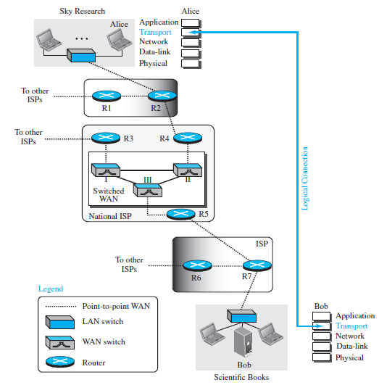
INTRODUCTION

Slide 6
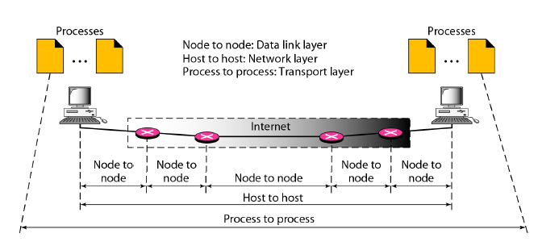
INTRODUCTION
Types of data deliveries

Slide 7
Functions of Transport Layer
Service-point addressing
Segmentation and reassembly
Connection control
Flow control
Error control

Slide 8
Functions of Transport Layer
Service-point addressing
Computers run several programs simultaneously due to this reason, the transmission of data from source to the destination not only from one computer to another computer but also from one process to another process.
The transport layer adds the header that contains the address known as a service-point address or port address.
The responsibility of the network layer is to transmit the data from one computer to another computer and the responsibility of the transport layer is to transmit the message to the correct process.

Slide 9
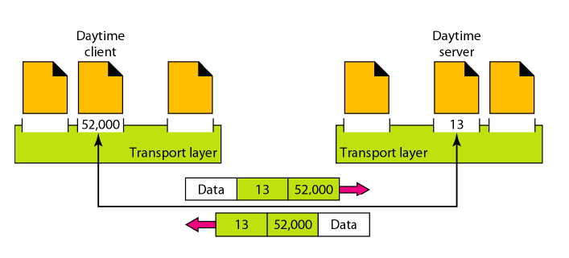
Functions of Transport Layer
Port numbers

Slide 10
Functions of Transport Layer
Segmentation and reassembly:
When the transport layer receives the message from the upper layer, it divides the message into multiple segments, and each segment is assigned with a sequence number that uniquely identifies each segment.
When the message has arrived at the destination, then the transport layer reassembles the message based on their sequence numbers.

Slide 11
Functions of Transport Layer
Connection control:
Transport layer provides two services Connection-oriented service and connectionless service.
A connectionless service treats each segment as an individual packet, and they all travel in different routes to reach the destination.
A connection-oriented service makes a connection with the transport layer at the destination machine before delivering the packets. In connection-oriented service, all the packets travel in the single route.

Slide 12
Functions of Transport Layer
Flow control:
The transport layer also responsible for flow control but it is performed end-to-end rather than across a single link.
Error control:
The transport layer is also responsible for Error control. Error control is performed end-to-end rather than across the single link. The sender transport layer ensures that message reach at the destination without any error.

Slide 13
TRANSPORT-LAYER SERVICES
The transport layer is located between the network layer and the application layer.
The transport layer is responsible for providing services to the application layer; it receives services from the network layer.

Slide 14
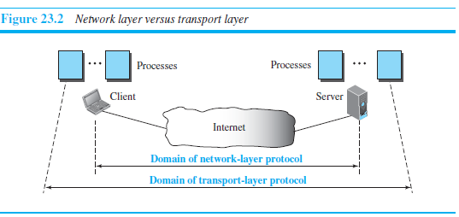
TRANSPORT-LAYER SERVICES
Process-to-Process Communication
The first duty of a transport-layer protocol is to provide process-to-process communication.
A process is an application-layer entity (running program) that uses the services of the transport layer.

Slide 15
TRANSPORT-LAYER SERVICES
The network layer is responsible for communication at the computer level (host-to-host communication).
A network-layer protocol can deliver the message only to the destination computer.
However, this is an incomplete delivery.
The message still needs to be handed to the correct process.
This is where a transport-layer protocol takes over.
A transport-layer protocol is responsible for delivery of the message to the appropriate process.

Slide 16
TRANSPORT-LAYER SERVICES
Addressing: Port Numbers
There are a few ways to achieve process-to-process communication, the most common is through the client-server paradigm.
A process on the local host, called a client, needs services from a process usually on the remote host, called a server.

Slide 17
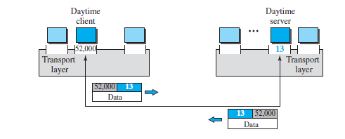
TRANSPORT-LAYER SERVICES
A remote computer can run several server programs at the same time, just as several local computers can run one or more client programs at the same time.
For communication, we must define the local host, local process, remote host, and remote process.
The local host and the remote host are defined using IP addresses.
To define the processes, we need second identifiers, called port numbers.

Slide 18
TRANSPORT-LAYER SERVICES
The destination IP address defines the host among the different hosts in the world. After the host has been selected, the port number defines one of the processes on this particular host
IP addresses versus port numbers

Slide 19
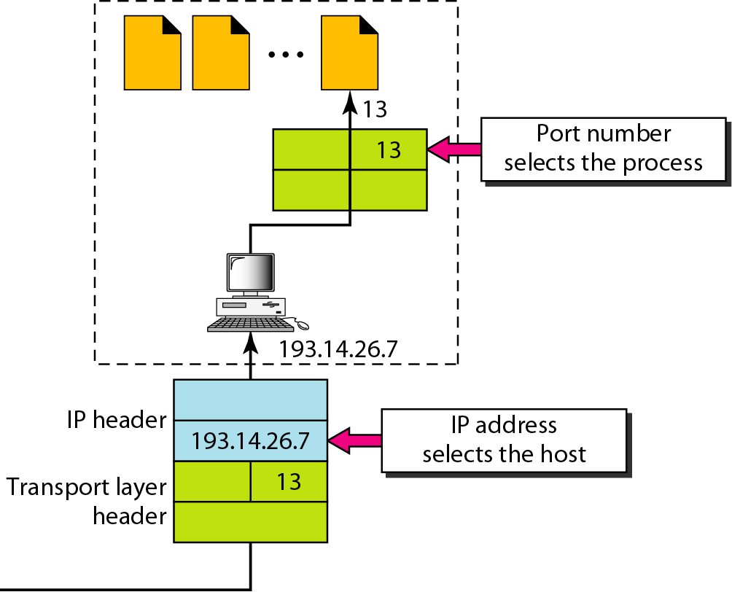

Slide 20
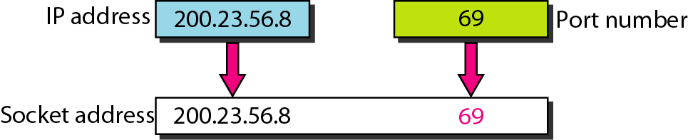
TRANSPORT-LAYER SERVICES
Socket Addresses
A transport-layer protocol in the TCP suite needs both the IP address and the port number, at each end, to make a connection.
The combination of an IP address and a port number is called a socket address.
The client socket address defines the client process uniquely just as the server socket address defines the server process uniquely.

Slide 21
TRANSPORT-LAYER SERVICES
To use the services of the transport layer in the Internet, we need a pair of socket addresses: the client socket address and the server socket address.
These four pieces of information are part of the network-layer packet header and the transport-layer packet header.
The first header contains the IP addresses; the second header contains the port numbers.

Slide 22
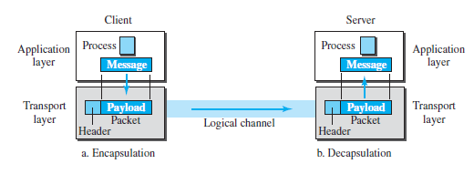
TRANSPORT-LAYER SERVICES
Encapsulation and Decapsulation
To send a message from one process to another, the transport-layer protocol encapsulates and decapsulates messages

Slide 23
TRANSPORT-LAYER SERVICES
Encapsulation happens at the sender site. When a process has a message to send, it passes the message to the transport layer along with a pair of socket addresses and some other pieces of information, which depend on the transport-layer protocol.
The transport layer receives the data and adds the transport-layer header.
The packets at the transport layer in the Internet are called user datagrams, segments, or packets.

Slide 24
TRANSPORT-LAYER SERVICES
Decapsulation happens at the receiver site. When the message arrives at the destination transport layer, the header is dropped and the transport layer delivers the message to the process running at the application layer.
The sender socket address is passed to the process in case it needs to respond to the message received.

Slide 25
TRANSPORT-LAYER SERVICES
Multiplexing and Demultiplexing
Whenever an entity accepts items from more than one source, this is referred to as multiplexing (many to one);
whenever an entity delivers items to more than one destination, this is referred to as demultiplexing (one to many).
The transport layer at the source performs multiplexing; the transport layer at the destination performs demultiplexing

Slide 26
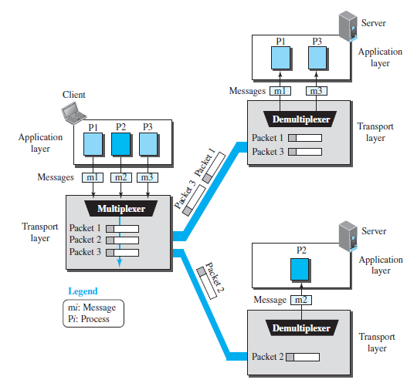

Slide 27
TRANSPORT-LAYER SERVICES
Flow Control
Whenever an entity produces items and another entity consumes them, there should be a balance between production and consumption rates.
If the items are produced faster than they can be consumed, the consumer can be overwhelmed and may need to discard some items.
If the items are produced more slowly than they can be consumed, the consumer
must wait, and the system becomes less efficient.
Flow control is related to the first issue. We need to prevent losing the data items at the consumer site.

Slide 28
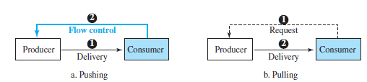
TRANSPORT-LAYER SERVICES
Pushing or Pulling
Delivery of items from a producer to a consumer can occur in one of two ways: pushing or pulling.
If the sender delivers items whenever they are produced without a prior request from the consumer the delivery is referred to as pushing.
If the producer delivers the items after the consumer has requested them, the delivery is referred to as pulling.

Slide 29
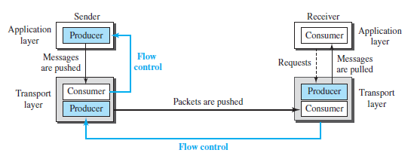
TRANSPORT-LAYER SERVICES
Flow Control at Transport Layer

Slide 30

TRANSPORT-LAYER SERVICES
Error Control
In the Internet, since the underlying network layer (IP) is unreliable,
Need to make the transport layer reliable if the application requires reliability.
Reliability can be achieved to add error control services to the transport layer.
Error control at the transport layer is responsible for
1. Detecting and discarding corrupted packets.
2. Keeping track of lost and discarded packets and resending them.
3. Recognizing duplicate packets and discarding them.
4. Buffering out-of-order packets until the missing packets arrive.

Slide 31
Connectionless and Connection-Oriented Protocols
A transport-layer protocol, like a network-layer protocol, can provide two types of services: connectionless and connection-oriented.
The nature of these services at the transport layer, however, is different from the ones at the network layer.
At the network layer, a connectionless service may mean different paths for different datagrams belonging to the same message.
At the transport layer, we are not concerned about the physical paths of packets (we assume a logical connection between two transport layers).
Connectionless service at the transport layer means independency between packets; connection-oriented means dependency.

Slide 32
Connectionless Service
In a connectionless service, the source process (application program) needs to divide its message into chunks of data of the size acceptable by the transport layer and deliver them to the transport layer one by one.
The transport layer treats each chunk as a single unit without any relation between the chunks.
When a chunk arrives from the application layer, the transport layer encapsulates it in a packet and sends it.
To show the independency of packets, assume that a client process has three chunks of messages to send to a server process.
The chunks are handed over to the connectionless transport protocol in order.
However, since there is no dependency between the packets at the transport layer, the packets may arrive out of order at the destination and will be delivered out of order to the server process.

Slide 33
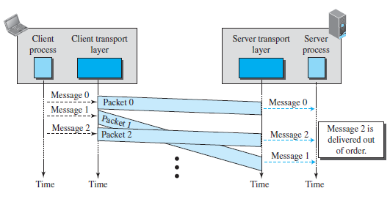
Connectionless Service
The Figure shows the movement of packets using a time line assumed that the delivery of the process to the transport layer and vice versa are instantaneous.
The figure shows that at the client site, the three chunks of messages are delivered to the client transport layer in order (0, 1, and 2).
Because of the extra delay in transportation of the second packet, the delivery of messages at the server is not in order (0, 2, 1).
The situation would be worse if one of the packets were lost. Since there is no numbering on the packets, the receiving transport layer has no idea that one of the messages has been lost.
It just delivers two chunks of data to the server process.
Problems arise from the fact that the two transport layers do not coordinate with each other.
The receiving transport layer does not know when the first packet will come nor when all of the packets have arrived.
So, no flow control, error control, or congestion control can be effectively implemented in a connectionless service.

Slide 34
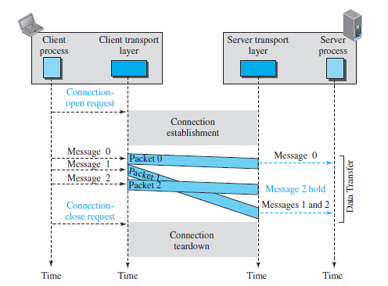
Connection-Oriented Service
In a connection-oriented service, the client and the server first need to establish a logical connection between themselves.
The data exchange can only happen after the connection establishment. After data exchange, the connection needs to be torn down.
At the transport layer, connection-oriented service involves only the two hosts; the service is end to end.
Means that a connection-oriented protocol at the transport layer over either a connectionless or connection-oriented protocol at the network layer.
Figure shows the connection establishment, data-transfer, and tear-down phases in a connection-oriented service at the transport layer.
Can implement flow control, error control, and congestion control in a connection oriented protocol.

Slide 35
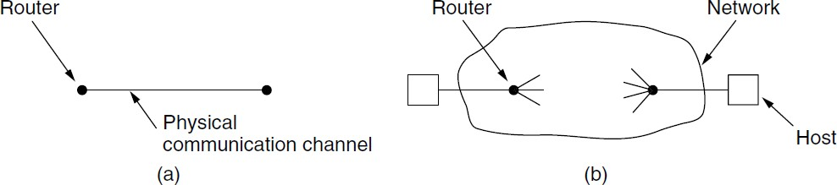
ELEMENTS OF TRANSPORT PROTOCOL
Transport protocol similar to data link protocols
Both do error control and flow control
However, significant differences exist
Environment of the data link layer
Environment of the transport layer

Slide 36
At the data link layer, two routers communicate directly via a physical channel, whether wired or wireless, whereas
at the transport layer, this physical channel is replaced by the entire network

Slide 37
ELEMENTS OF TRANSPORT PROTOCOL
Addressing
Connection Establishment
Connection Release
Error Control and Flow Control
Multiplexing
Crash Recovery

Slide 38
Addressing
When an application (e.g., a user) process wishes to set up a connection to a remote application process, it must specify which one to connect to.
The method normally used is to define transport addresses to which processes can listen for connection requests. In the Internet, these endpoints are called ports.
The generic term TSAP (Transport Service Access Point) to mean a specific endpoint in the transport layer.
The analogous endpoints in the network layer (i.e., network layer addresses) are called NSAPs (Network Service Access Points).
IP addresses are examples of NSAPs.

Slide 39
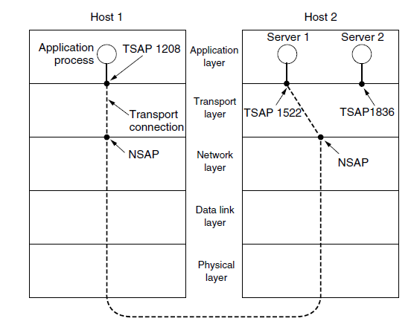
Addressing

Slide 40
Figure illustrates the relationship between the NSAPs(Network Service Access Points), the TSAPs(Transport Service Access Point), and a transport connection.
Application processes, both clients and servers, can attach themselves to a local TSAP to establish a connection to a remote TSAP.
These connections run through NSAPs on each host, as shown.

Slide 41
Addressing
A possible scenario for a transport connection is as follows:
1. A mail server process attaches itself to TSAP 1522 on host 2 to wait for an incoming call.
2. An application process on host 1 wants to send an email message, so it attaches itself to TSAP 1208 and issues a CONNECT request. The request specifies TSAP 1208 on host 1 as the source and TSAP 1522 on host 2 as the destination. This action ultimately results in a transport connection being established between the application process and the server.
3. The application process sends over the mail message.
4. The mail server responds to say that it will deliver the message.
5. The transport connection is released.

Slide 42
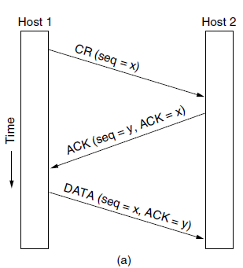
Addressing
A possible scenario for a transport connection is as follows

Slide 43
Connection Establishment
Host 1 chooses a sequence number, x, and sends a CONNECTION REQUEST segment containing it to host 2.
Host 2 replies with an ACK segment acknowledging x and announcing its own initial sequence number, y.
Finally, host 1 acknowledges host 2’s choice of an initial sequence number in the first data segment that it sends.

Slide 44
Connection Establishment
TCP uses this three-way handshake to establish connections.
Tomlinson (1975) introduced the three-way handshake.
This establishment protocol involves one peer checking with the other that the connection request is indeed current.
The normal setup procedure when host 1 initiates is shown in Fig.(a).

Slide 45
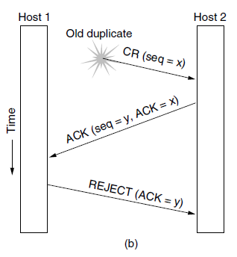
Connection Establishment

Slide 46
Let us see how the three-way handshake works in the presence of delayed duplicate control segments.
In Fig. (b), the first segment is a delayed duplicate CONNECTION REQUEST from an old connection. This segment arrives at host 2 without host 1’s knowledge.
Host 2 reacts to this segment by sending host 1 an ACK segment, in effect asking for verification that host 1 was indeed trying to set up a new connection.
When host 1 rejects host 2’s attempt to establish a connection, host 2 realizes that it was tricked by a delayed duplicate and abandons the connection.
In this way, a delayed duplicate does no damage.

Slide 47
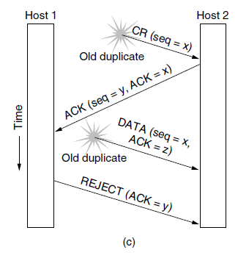
Connection Establishment

Slide 48
Connection Establishment
The worst case is when both a delayed CONNECTION REQUEST and an ACK are floating around in the subnet. This case is shown in Fig. (c).
As in the previous example, host 2 gets a delayed CONNECTION REQUEST and replies to it.
At this point, it is crucial to realize that host 2 has proposed using y as the initial sequence number for host 2 to host 1 traffic, knowing full well that no segments containing sequence number y or acknowledgements to y are still in existence.
When the second delayed segment arrives at host 2, the fact that z has been acknowledged rather than y tells host 2 that this, too, is an old duplicate.

Slide 49
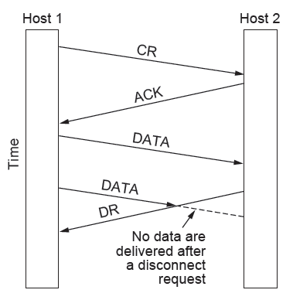
Connection Release
Easier than establish
However, some pitfalls
Asymmetric release
the way telephone works
1 party hangs up, con broken
abrupt; may cause data loss
better protocol needed

Slide 50
Connection Release
Symmetric release
Each direction is released independently
Can receive data after sending DISCONNECT
H1: I am done, are you done too?
H2: I am done too, goodbye

Slide 51
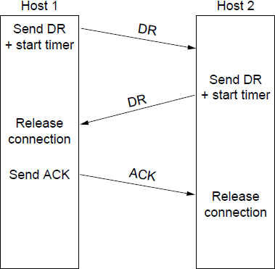
Connection Release
Let each side independently decide its done
Easier to solve
Normal release sequence
H1 send DR, start timer
H2 responds with DR
when H1 recv DR, release
when H2 recv ACK, release

Slide 52
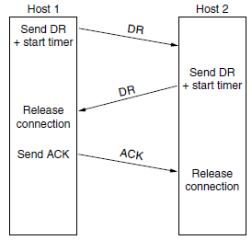
Connection Release
Normal 3 way communication

Slide 53
we see the normal case in which one of the users sends a DR
(DISCONNECTION REQUEST) segment to initiate the connection release.
When it arrives, the recipient sends back a DR segment and starts a timer, just in case its DR is lost.
When this DR arrives, the original sender sends back an ACK segment and releases the connection.
Finally, when the ACK segment arrives, the receiver also releases the connection.

Slide 54
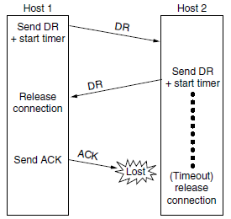
Connection Release
Final Acknowledgement Lost

Slide 55
If the final ACK segment is lost, as shown, the situation is saved by the timer.
When the timer expires, the connection is released anyway.

Slide 56
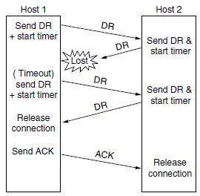
Connection Release
Response lost.

Slide 57
Now consider the case of the second DR being lost.
The user initiating the disconnection will not receive the expected response, will time out, and will start
all over again.
In Fig we see how this works, assuming that the second time no segments are lost and all segments are delivered correctly and on time.

Slide 58
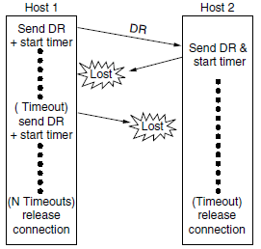
Connection Release
Response lost and subsequent DRs lost.

Slide 59
Our last scenario, Fig. 6-14(d), is the same as Fig. 6-14(c) except that now we
assume all the repeated attempts to retransmit the DR also fail due to lost segments.
After N retries, the sender just gives up and releases the connection.
Meanwhile, the receiver times out and also exits

Slide 60
Error Control and Flow Control
The key issues are error control and flow control.
Error control is ensuring that the data is delivered with the desired level of reliability, usually that all of the data is delivered without any errors.
Flow control is keeping a fast transmitter from overrunning a slow receiver.

Slide 61
Error Control and Flow Control
The solutions that are used at the transport layer are the same mechanisms that we studied in data link layer. As a very brief recap:
1. A frame carries an error-detecting code (e.g., a CRC or checksum) that is used to check if the information was correctly received.
2. A frame carries a sequence number to identify itself and is retransmitted by the sender until it receives an acknowledgement of successful receipt from the receiver. This is called ARQ (Automatic Repeat reQuest).
3. There is a maximum number of frames that the sender will allow to be outstanding at any time, pausing if the receiver is not acknowledging frames quickly enough. If this maximum is one packet the protocol is called stop-and-wait. Larger windows enable pipelining and improve performance on long, fast links.
4. The sliding window protocol combines these features and is also used to support bidirectional data transfer.

Slide 62
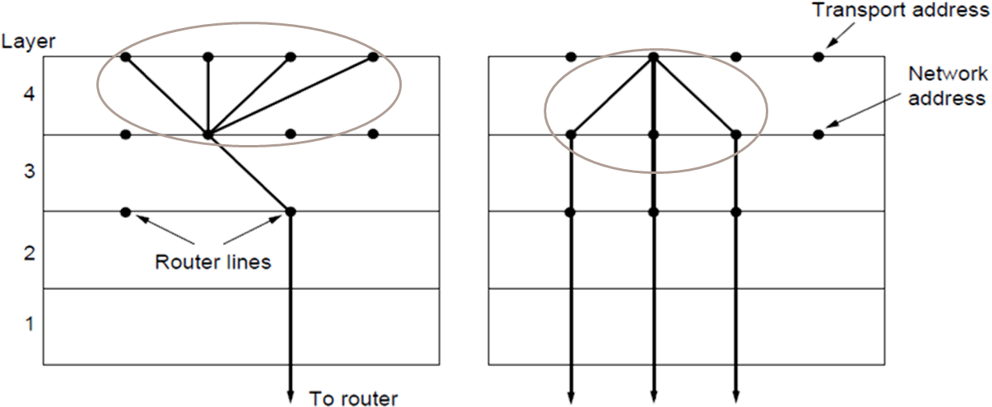
Multiplexing
Transport, network sharing can either be:
Multiplexing: connections share a network address
Inverse multiplexing: addresses share a connection
Multiplexing
Inverse Multiplexing
29

Slide 63
CRASH RECOVERY
If hosts and routers are subject to crashes or connections are long-lived (e.g., large software or media downloads), recovery from these crashes becomes an issue.
If the transport entity is entirely within the hosts, recovery from network and router crashes is straightforward.
The transport entities expect lost segments all the time and know how to cope with them by using retransmissions.

Slide 64
THE INTERNET TRANSPORT PROTOCOLS
The Internet has two main protocols in the transport layer, a connectionless protocol and a connection-oriented one.
The connectionless protocol is UDP (User Datagram Protocol).
The connection-oriented protocol is TCP (Transmission Control Protocol).

Slide 65
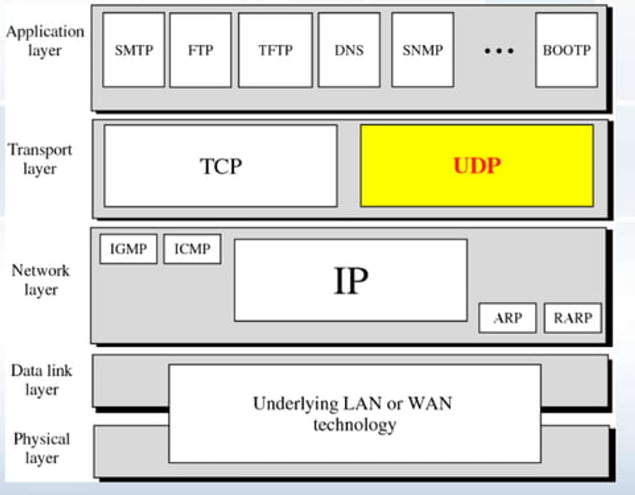
Position of UDP in the TCP/IP protocol suite

Slide 66
UDP (User Datagram Protocol)
UDP stands for User Datagram Protocol.
UDP is a simple protocol and it provides nonsequenced transport functionality.
UDP is a connectionless protocol.
This type of protocol is used when reliability and security are less important than speed and size.
No flowcontrol
UDP is an end-to-end transport level protocol that adds transport-level addresses, checksum error control, and length information to the data from the upper layer.
The packet produced by the UDP protocol is known as a user datagram.

Slide 67
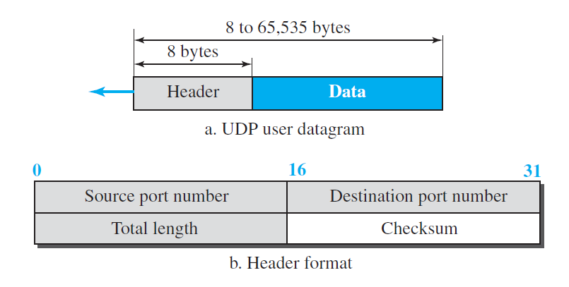
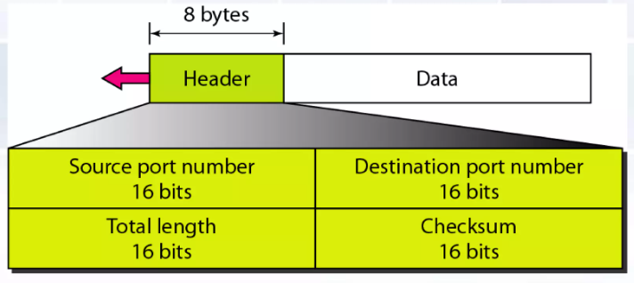
UDP Header Format
UDP packets, called user datagrams, have a fixed-size header of 8 bytes made of four fields, each of 2 bytes (16 bits).

Slide 68
UDP Header Format
Source port address: It defines the address of the application process that has delivered a message. The source port address is of 16 bits address.
Destination port address: It defines the address of the application process that will receive the message. The destination port address is of a 16-bit address.
Total length: It defines the total length of the user datagram in bytes (Including Header). It is a 16-bit field.
Checksum: The checksum is a 16-bit field which is used in error detection.

Slide 69
UDP Services
Process-to-Process Communication
UDP provides process-to-process communication using socket addresses, a combination of IP addresses and port numbers.
Connectionless Services
UDP provides a connectionless service.
This means that each user datagram sent by UDP is an independent datagram.
There is no relationship between the different user datagrams even if they are coming from the same source process and going to the same destination program.
Flow Control
UDP is a very simple protocol.
There is no flow control, and hence no window mechanism.

Slide 70
UDP Services
Error Control
There is no error control mechanism in UDP except for the checksum.
This means that the sender does not know if a message has been lost or duplicated.
When the receiver detects an error through the checksum, the user datagram is silently discarded.
Congestion Control
Since UDP is a connectionless protocol, it does not provide congestion control.
UDP assumes that the packets sent are small and sporadic and cannot create congestion in the network.

Slide 71
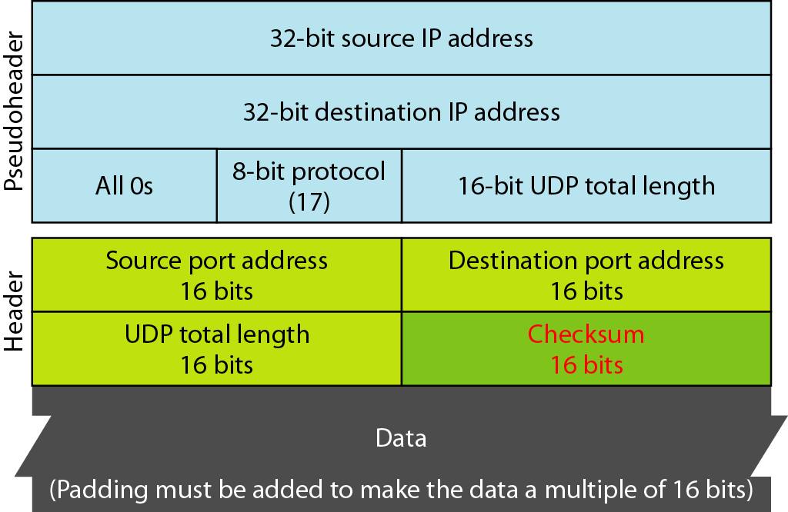

Slide 72
UDP Services
Checksum
UDP checksum calculation includes three sections: a pseudoheader, the UDP header, and the data coming from the application layer.
The pseudoheader is the part of the header of the IP packet in which the user datagram is to be encapsulated with some fields filled with 0s
Pseudoheader for checksum calculation

Slide 74
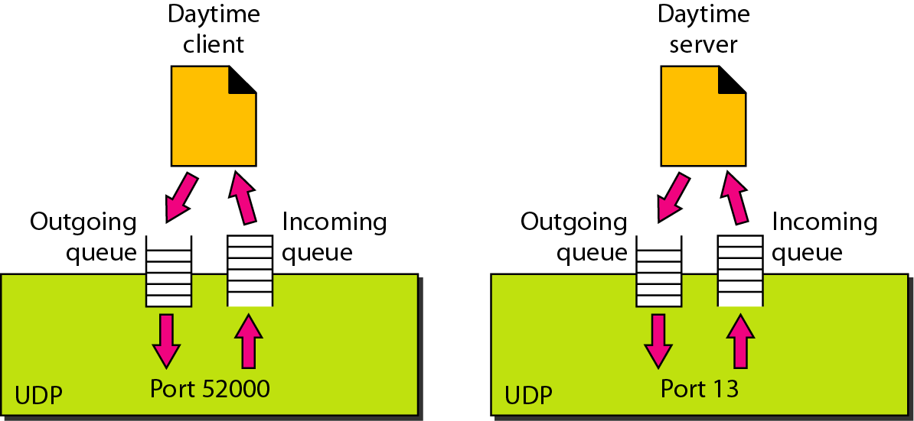
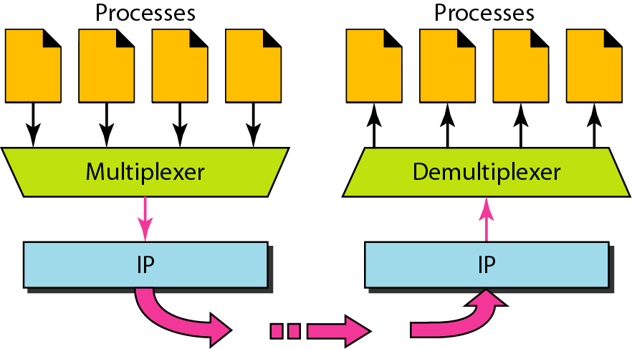
UDP Services
Queues in UDP
Encapsulation and Decapsulation
To send a message from one process to another, the UDP protocol encapsulates and decapsulates messages.
Queuing
In UDP, queues are associated with ports.
At the client site, when a process starts, it requests a port number from the operating system.
Some implementations create both an incoming and an outgoing queue associated with each process. Other implementations create only an incoming queue associated with each process.
Multiplexing and Demultiplexing
In a host running a TCP/IP protocol suite, there is only one UDP but possibly several processes that may want to use the services of UDP.
To handle this situation, UDP multiplexes and demultiplexes.
Multiplexing and demultiplexing

Slide 75
TCP (TRANSMISSION CONTROL PROTOCOL)
TCP stands for Transmission Control Protocol.
It provides full transport layer services to applications.
It is a connection-oriented protocol means the connection established between both the ends of the transmission.
For creating the connection, TCP generates a virtual circuit between sender and receiver for the duration of a transmission.

Slide 76
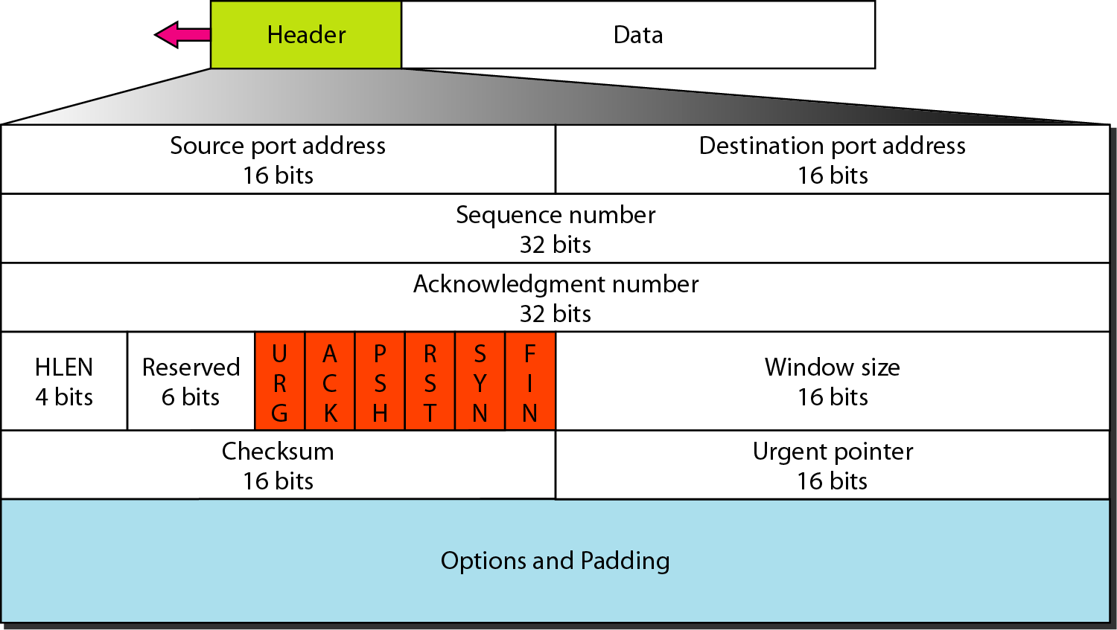
TCP segment format
A packet in TCP is called a segment.
The header is 20 bytes if there are no options and up to 60 bytes if it contains options
The format of a segment is shown in Figure below

Slide 77
TCP segment format
Source port address: This is a 16-bit field that defines the port number of the application program in the host that is sending the segment.
Destination port address: This is a 16-bit field that defines the port number of the application program in the host that is receiving the segment.
Sequence number: A stream of data is divided into two or more TCP segments. The 32-bit sequence number field represents the position of the data in an original data stream.
Acknowledgement number: A 32-field acknowledgement number acknowledge the data from other communicating devices. If ACK field is set to 1, then it specifies the sequence number that the receiver is expecting to receive.

Slide 78
TCP segment format
Header Length (HLEN): It specifies the size of the TCP header in 32-bit words. The minimum size of the header is 5 words, and the maximum size of the header is 15 words. Therefore, the maximum size of the TCP header is 60 bytes, and the minimum size of the TCP header is 20 bytes.
Reserved: It is a six-bit field which is reserved for future use.

Slide 79
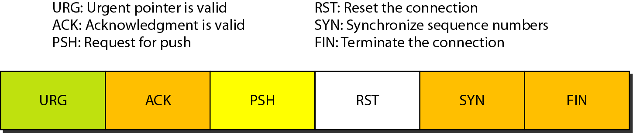
TCP segment format
Control bits: Each bit of a control field functions individually and independently. A control bit defines the use of a segment or serves as a validity check for other fields.
There are total six types of flags in control field:
URG: The URG field indicates that the data in a segment is urgent.
ACK: When ACK field is set, then it validates the acknowledgement number.
PSH: The PSH field is used to inform the sender that higher throughput is needed so if possible, data must be pushed with higher throughput.
RST: The reset bit is used to reset the TCP connection when there is any confusion occurs in the sequence numbers.
SYN: The SYN field is used to synchronize the sequence numbers in three types of segments: connection request, connection confirmation ( with the ACK bit set ), and confirmation acknowledgement.
FIN: The FIN field is used to inform the receiving TCP module that the sender has finished sending data. It is used in connection termination in three types of segments: termination request, termination confirmation, and acknowledgement of termination confirmation.

Slide 80
TCP segment format
Window Size: The window is a 16-bit field that defines the size of the window.
Checksum: The checksum is a 16-bit field used in error detection.
Urgent pointer: If URG flag is set to 1, then this 16-bit field is an offset from the sequence number indicating that it is a last urgent data byte.
Options and padding: It defines the optional fields that convey the additional information to the receiver.

Slide 81
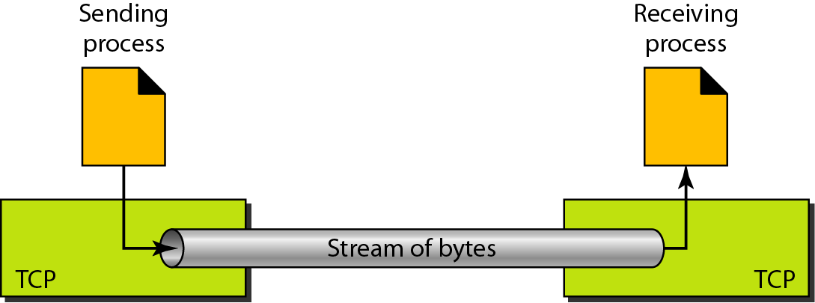
TCP Services
Process-to-Process Communication
TCP provides process-to-process communication using port numbers.
Stream Delivery Service
TCP, allows the sending process to deliver data as a stream of bytes and allows the receiving process to obtain data as a stream of bytes.
TCP creates an environment in which the two processes seem to be connected by an imaginary “tube” that carries their bytes across the Internet. This imaginary environment is depicted in Figure below.
The sending process produces (writes to) the stream and the receiving process consumes (reads from) it.

Slide 82
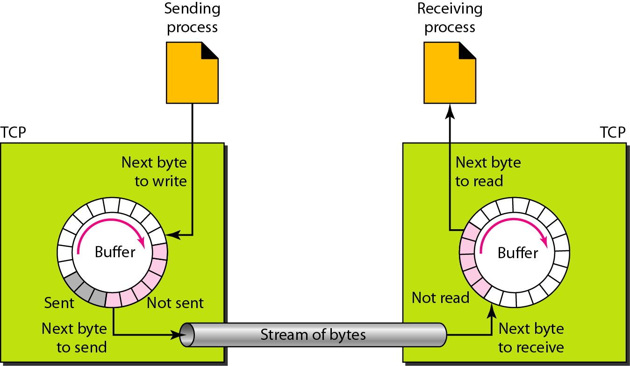
TCP Services
Sending and Receiving Buffers
The sending and the receiving processes may not necessarily write or read data at the same rate, TCP needs buffers for storage.
There are two buffers, the sending buffer and the receiving buffer, one for each direction.
One way to implement a buffer is to use a circular array of 1-byte locations as shown in Figure

Slide 83
TCP Services
The figure shows the movement of the data in one direction.
At the sender, the buffer has three types of chambers.
The white section contains empty chambers that can be filled by the sending process (producer).
The colored (blue) area holds bytes that have been sent but not yet acknowledged. The TCP sender keeps these bytes in the buffer until it receives an acknowledgment.
The shaded area contains bytes to be sent by the sending TCP.
The operation of the buffer at the receiver is simpler. The circular buffer is divided into two areas (shown as white and colored).
The white area contains empty chambers to be filled by bytes received from the network.
The colored sections contain received bytes that can be read by the receiving process. When a byte is read by the receiving process, the chamber is recycled and added to the pool of empty chambers.

Slide 84
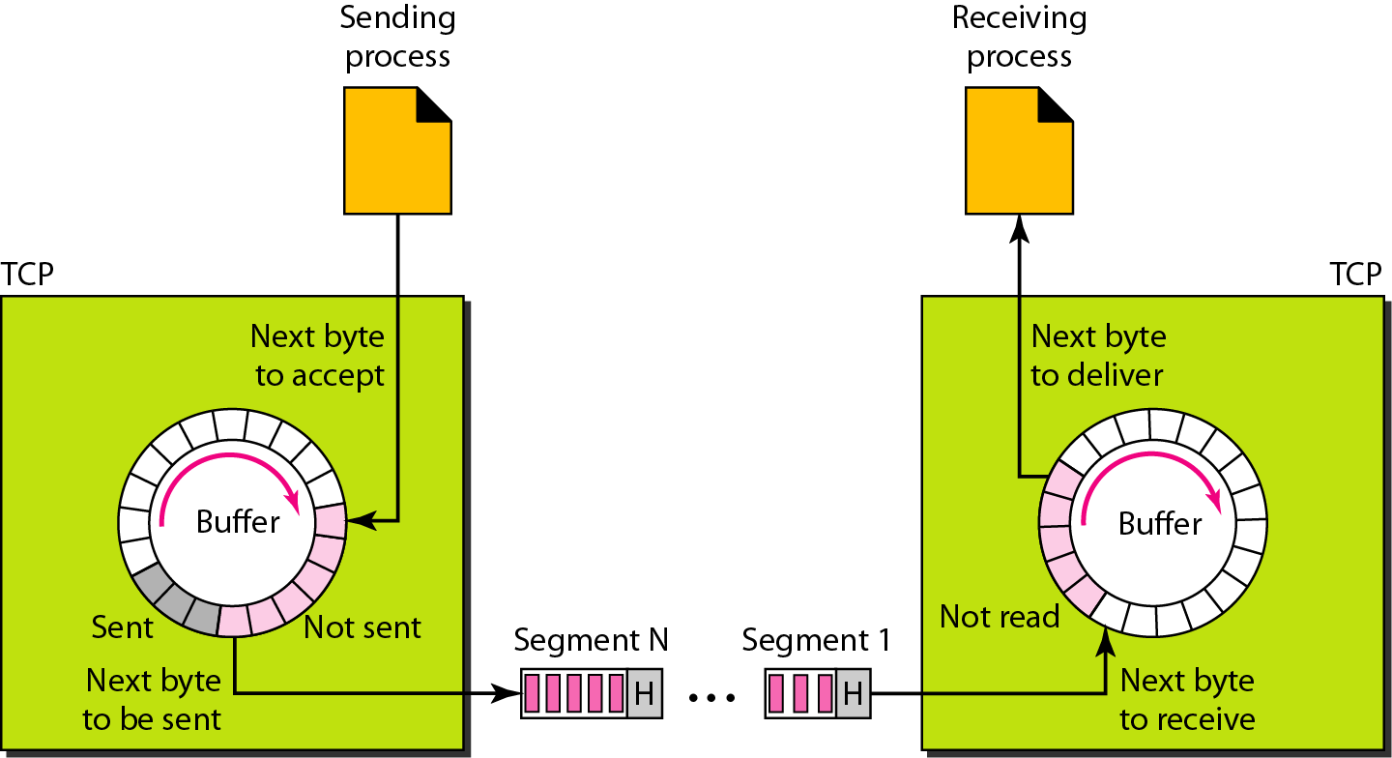
TCP Services
Segments
Although buffering handles the disparity between the speed of the producing and consuming processes, we need one more step before we can send data.
The network layer, as a service provider for TCP, needs to send data in packets, not as a stream of bytes.
At the transport layer, TCP groups a number of bytes together into a packet called a segment.
TCP adds a header to each segment (for control purposes) and delivers the segment to the network layer for transmission. The segments are encapsulated in an IP datagram and transmitted.

Slide 85
TCP Services
Full-Duplex Communication
TCP offers full-duplex service, where data can flow in both directions at the same time.
Each TCP endpoint then has its own sending and receiving buffer, and segments move in both directions.
Multiplexing and Demultiplexing
Like UDP, TCP performs multiplexing at the sender and demultiplexing at the receiver.
However, since TCP is a connection-oriented protocol, a connection needs to be established for each pair of processes.

Slide 86
TCP Services
Connection-Oriented Service
TCP, unlike UDP, is a connection-oriented protocol. When a process at site A wants to send to and receive data from another process at site B, the following three phases occur:
1. The two TCP’s establish a logical connection between them.
2. Data are exchanged in both directions.
3. The connection is terminated.
Note that this is a logical connection, not a physical connection.
The TCP segment is encapsulated in an IP datagram and can be sent out of order, or lost or corrupted, and then resent.
Each may be routed over a different path to reach the destination.
There is no physical connection. TCP creates a stream-oriented environment in which it accepts the responsibility of delivering the bytes in order to the other site.
Reliable Service
TCP is a reliable transport protocol. It uses an acknowledgment mechanism to check the safe and sound arrival of data.

Slide 87
A TCP Connection Management
TCP is connection-oriented.
A connection-oriented transport protocol establishes a logical path between the source and destination.
All of the segments belonging to a message are then sent over this logical path.
Using a single logical pathway for the entire message facilitates the acknowledgment process as well as retransmission of damaged or lost frames.
If a segment arrives out of order, TCP holds it until the missing segments arrive; IP is unaware of this reordering.
In TCP, connection-oriented transmission requires three phases: connection establishment, data transfer, and connection termination.

Slide 88
TCP: Connection Establishment
TCP transmits data in full-duplex mode.
When two TCPs in two machines are connected, they are able to send segments to each other simultaneously.
This implies that each party must initialize communication and get approval from the other party before any data are transferred.
The connection establishment in TCP is called three-way handshaking.
For example, an application program, called the client, wants to make a connection with another application program, called the server, using TCP as the transport-layer protocol.

Slide 89
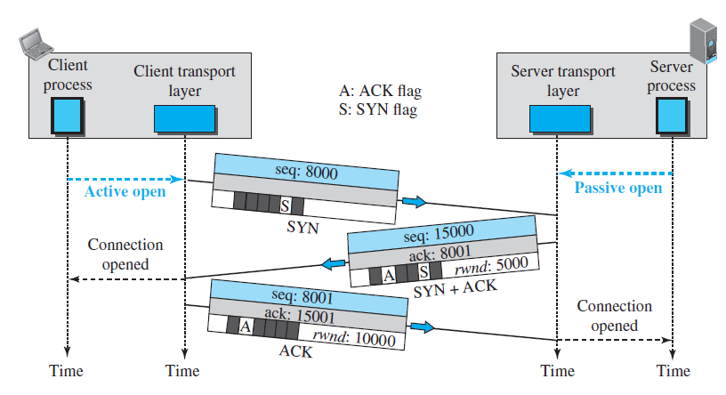
TCP: Connection Establishment
The process starts with the server.
The server program tells its TCP that it is ready to accept a connection. This request is called a passive open.
The server TCP is ready to accept a connection from any machine in the world.
But it cannot make the connection itself.
The client program issues a request for an active open.
A client that wishes to connect to an open server tells its TCP to connect to a particular server.
TCP can now start the three-way handshaking process, as shown in Figure.

Slide 90
The three steps in this phase are as follows.
The client sends the first segment, a SYN segment, in which only the SYN flag is set. This segment is for synchronization of sequence numbers. This sequence number is called the initial sequence number (ISN). This segment does not contain an acknowledgment number. It does not define the window size either; a window size definition makes sense only when a segment includes an acknowledgment.
The server sends the second segment, a SYN + ACK segment with two flag bits set as: SYN and ACK. This segment has a dual purpose. First, it is a SYN segment for communication in the other direction. The server uses this segment to initialize a sequence number for numbering the bytes sent from the server to the client. The server also acknowledges the receipt of the SYN segment from the client by setting the ACK flag and displaying the next sequence number it expects to receive from the client. Because the segment contains an acknowledgment, it also needs to define the receive window size, rwnd (to be used by the client).

Slide 91
3. The client sends the third segment. This is just an ACK segment. It acknowledges the receipt of the second segment with the ACK flag and acknowledgment number field. Note that the ACK segment does not consume any sequence numbers if it does not carry data,

Slide 92
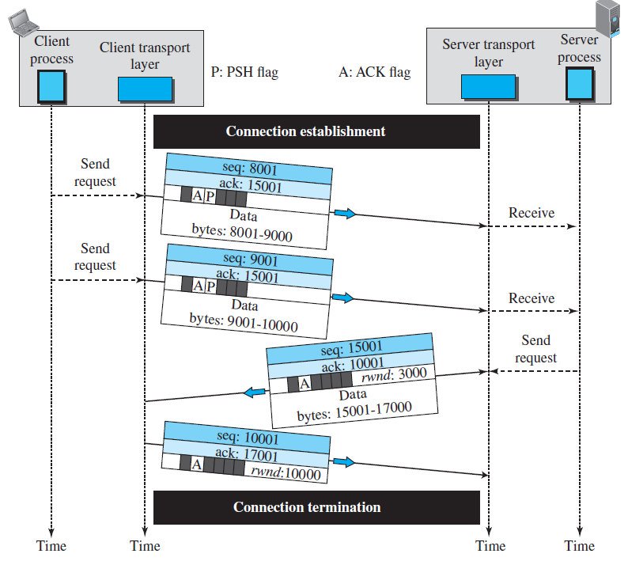
TCP: Data Transfer
After connection is established, bidirectional data transfer can take place. The client and server can send data and acknowledgments in both directions.
Data traveling in the same direction as an acknowledgment are carried on the same segment. The acknowledgment is piggybacked with the data.
Figure shows an example.

Slide 93
In this example, after a connection is established, the client sends 2,000 bytes of data in two segments. The server then sends 2,000 bytes in one segment.
The client sends one more segment. The first three segments carry both data and acknowledgment, but the last segment carries only an acknowledgment because there is no more data to be sent.
Note the values of the sequence and acknowledgment numbers.
The data segments sent by the client have the PSH (push) flag set so that the server TCP knows to deliver data to the server process as soon as they are received.
The segment from the server, on the other hand, does not set the push flag

Slide 94
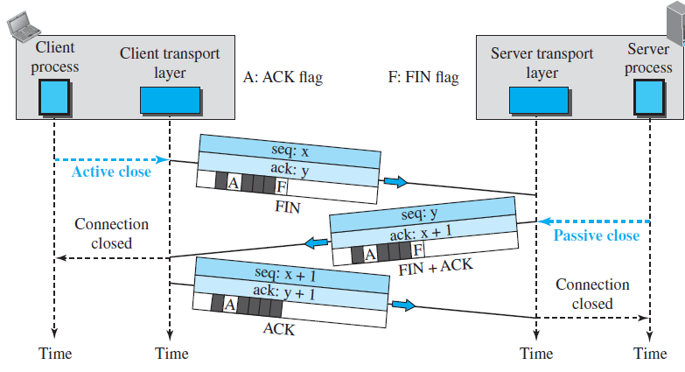
TCP: Connection Termination
Either of the two parties involved in exchanging data (client or server) can close the connection, although it is usually initiated by the client.
Most implementations today allow three-way handshaking for connection termination, as shown in Figure.

Slide 95
In this situation, the client TCP, after receiving a close command from the client process, sends the first segment, a FIN segment in which the FIN flag is set. It is only a control segment, it consumes only one sequence number because it needs to be acknowledged.
The server TCP, after receiving the FIN segment, informs its process of the situation and sends the second segment, a FIN + ACK segment, to confirm the receipt of the FIN segment from the client and at the same time to announce the closing of the connection in the other direction. It consumes only one sequence number because it needs to be acknowledged.
The client TCP sends the last segment, an ACK segment, to confirm the receipt of the FIN segment from the TCP server. This segment contains the acknowledgment number, which is one plus the sequence number received in the FIN segment from the server. This segment cannot carry data and consumes no sequence numbers.

Slide 96
Difference between TCP and UDP
TCP | UDP
It stands for Transmission Control Protocol. | It stands for User Datagram Protocol.
It is a connection-oriented protocol, which means that the connection needs to be established before the data is transmitted over the network. | It is a connectionless protocol, which means that it sends the data without checking whether the system is ready to receive or not.
TCP is a reliable protocol as it provides assurance for the delivery of data packets. | UDP is an unreliable protocol as it does not take the guarantee for the delivery of packets.
TCP is slower than UDP as it performs error checking, flow control, and provides assurance for the delivery of | UDP is faster than TCP as it does not guarantee the delivery of data packets.
The size of TCP header is 20 to 60 bytes. | The size of the UDP header is 8 bytes.
It follows the flow control mechanism in which too many packets cannot be sent to the receiver at the same time. | This protocol follows no such mechanism.
TCP performs error checking by using a checksum. When the data is corrected, then the data is retransmitted to the receiver. | It does not perform any error checking, and also does not resend the lost data packets.
This protocol is mainly used where a secure and reliable communication process is required, like military services, web browsing, and e-mail. | This protocol is used where fast communication is required and does not care about the reliability like VoIP, game streaming, video and music streaming, etc.

